Slide 1


Cleveland Cavaliers Hackathon 2023
Presented by: Brogan Berkey and Liam Jennings

Slide 2
Explanation of Process Followed to Develop Model
Wanted to look at this project as Business Analysts
Our focus was to ensure high attendance and ticket revenue
Begun by defining and adding additional variables into the dataset
Data Dictionary listed on next slide
Decided to run multiple linear regression for attendance
Realized that the majority of games were sellouts, resulting in poor prediction capabilities
Instead of attendance, wanted to look at popularity
Our focus changed from selling tickets to pricing tickets
Unable to calculate a reliable metric for game popularity for a prediction model
Created a k-means clustering model in order to group the games
From the information provided by k-means, able to tier games based on popularity

Slide 3
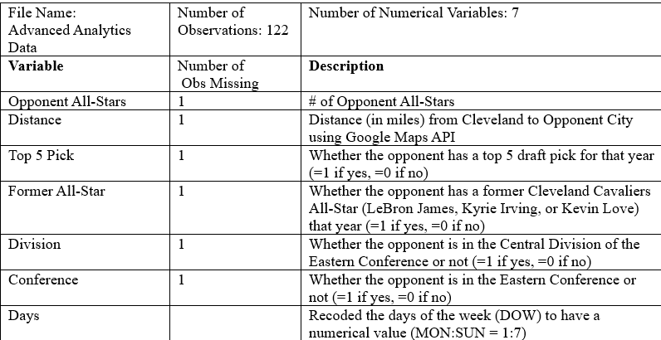
Data Description/Dictionary

Slide 4
Description of Chosen Criteria and its Importance
Variables
Opponent All-Star
Fans may want to see a more competitive game (teams with more all-stars) than a blowout (teams with less all-stars)
Distance
Can determine how far opposing fans are traveling
The closer the opposing team, we expect more fans will travel to the game
Top 5 Pick
Fans want to see the new faces of the league
Former All-Star
Fans want to see their beloved stars play their old team
Division
Division games are more important than not
Conference
Conference games are more important than not
Days
Fans have better attendance on certain days (e.g., weekends)
Methods
Multiple Linear Regression
We attempted to tier games by using a multiple linear regression
Target variable: attendance
Goal was to predict future attendance and determine which variables were most important
k-means Clustering
Shifted focus from ticket sales to ticket price
We wanted to predict popularity of each game instead of attendance
Clustering allowed us to group games and tier them

Slide 5
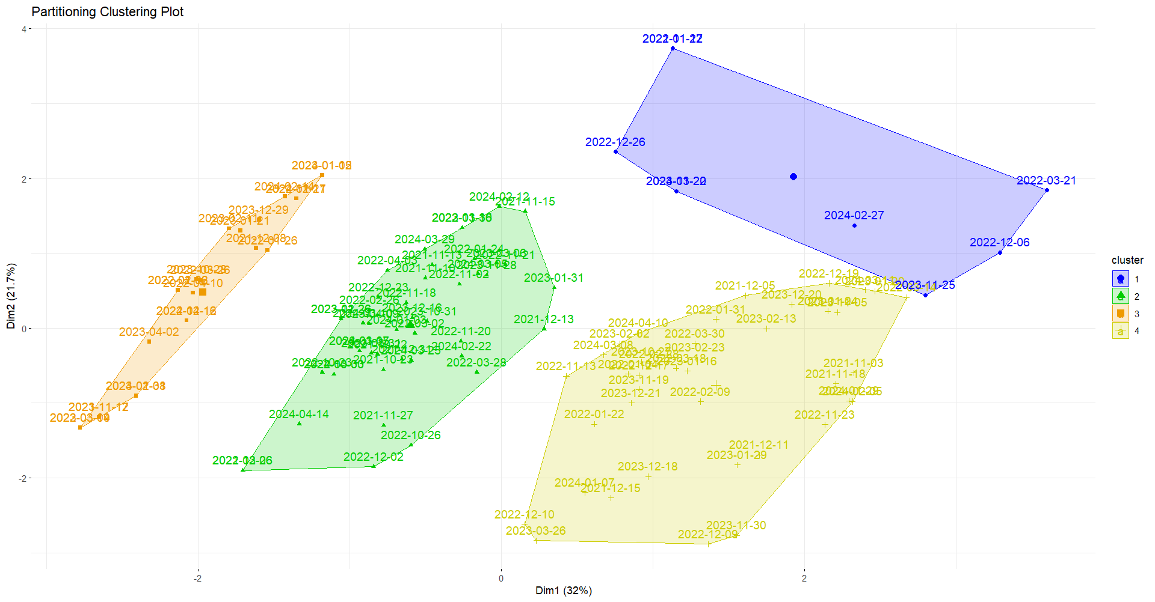
Demonstration of Model Performance on Schedule
Our model was able to cluster the Cavalier’s schedule into four categories using the variables already discussed
In order to gain the most accurate clusters, all seasons were included in the model
This way, the 2023-2024 season tiers will be based off of the past two seasons
A more detailed output of the k-means clustering model are depicted on the following slide

Slide 6
Cluster Information
Cluster 1
Opponent All-Stars | 1.5556
Former All-Stars | 1
Distance | 1345.9004
Top 5 Picks | 0
Division | 0
Conference | 0.5555
Days | 2.2222
Cluster 2
Opponent All-Stars | 0.8780
Former All-Stars | 0
Distance | 1597.2928
Top 5 Picks | 0.1707
Division | 0
Conference | 0
Days | 3.8293
Cluster 3
Opponent All-Stars | 0.9583
Former All-Stars | 0
Distance | 315.7136
Top 5 Picks | .2500
Division | 1
Conference | 1
Days | 4.6667
Cluster 4
Opponent All-Stars | 0.7872
Former All-Stars | 0
Distance | 592.0245
Top 5 Picks | 0.1702
Division | 0
Conference | 1
Days | 4.3191

Slide 7
Metrics or Evaluation Measures Used to Assess Quality of Tiering
While the attendance numbers do not change from cluster to cluster, we understand that the general popularity of each cluster fluctuates
To capture this popularity factor, the cluster centers and means were used to determine the differences between clusters
Each cluster center’s means were evaluated and determined to impact popularity to different degrees, which led to the overall tiering of games
With the absence of a popularity metric, logical reasoning was conducted to determine the tiering of the clusters

Slide 8
Tier One
Event Date | DOW | Opponent | Cluster
10/28/2023 | SAT | Indiana Pacers | 3
11/17/2023 | FRI | Detroit Pistons | 3
12/29/2023 | FRI | Milwaukee Bucks | 3
1/15/2024 | MON | Chicago Bulls | 3
1/17/2024 | WED | Milwaukee Bucks | 3
1/31/2024 | WED | Detroit Pistons | 3
2/14/2024 | WED | Chicago Bulls | 3
4/12/2024 | FRI | Indiana Pacers | 3
K-Means Centers
Opponent All-Stars: 0.9583
Former All-Stars: 0
Distance: 315.7136
Top 5 Picks: .2500
Division: 1
Conference: 1
Days: 4.6667

Slide 9
Tier Two
Event Date | DOW | Opponent | Cluster
11/22/2023 | WED | Miami Heat | 1
11/25/2023 | SAT | Los Angeles Lakers | 1
2/27/2024 | TUE | Dallas Mavericks | 1
3/20/2024 | WED | Miami Heat | 1
K-Means Centers
Opponent All-Stars: 1.5556
Former All-Stars: 1
Distance: 1345.9004
Top 5 Picks: 0
Division: 0
Conference: .5555
Days: 2.2222

Slide 10
Tier Three
Event Date | DOW | Opponent | Cluster
10/31/2023 | TUE | New York Knicks | 4
11/26/2023 | SUN | Toronto Raptors | 4
11/28/2023 | TUE | Atlanta Hawks | 4
12/16/2023 | SAT | Atlanta Hawks | 4
1/3/2024 | WED | Washington Wizards | 4
1/5/2024 | FRI | Washington Wizards | 4
2/12/2024 | MON | Philadelphia 76ers | 4
2/22/2024 | THU | Orlando Magic | 4
3/3/2024 | SUN | New York Knicks | 4
3/5/2024 | TUE | Boston Celtics | 4
3/10/2024 | SUN | Brooklyn Nets | 4
3/25/2024 | MON | Charlotte Hornets | 4
3/29/2024 | FRI | Philadelphia 76ers | 4
4/14/2024 | SUN | Charlotte Hornets | 4
K-Means Centers
Opponent All-Stars: 0.7872
Former All-Stars: 0
Distance: 592.0245
Top 5 Picks: 0.1702
Division: 0
Conference: 1
Days: 4.3191

Slide 11
Tier Four
Event Date | DOW | Opponent | Cluster
10/27/2023 | FRI | Oklahoma City Thunder | 2
11/5/2023 | SUN | Golden State Warriors | 2
11/19/2023 | SUN | Denver Nuggets | 2
11/30/2023 | THU | Portland Trail Blazers | 2
12/18/2023 | MON | Houston Rockets | 2
12/20/2023 | WED | Utah Jazz | 2
12/21/2023 | THU | New Orleans Pelicans | 2
1/7/2024 | SUN | San Antonio Spurs | 2
1/29/2024 | MON | Los Angeles Clippers | 2
2/5/2024 | MON | Sacramento Kings | 2
3/8/2024 | FRI | Minnesota Timberwolves | 2
3/11/2024 | MON | Phoenix Suns | 2
4/10/2024 | WED | Memphis Grizzlies | 2
K-Means Centers
Opponent All-Stars: 0.8780
Former All-Stars: 0
Distance: 1597.2982
Top 5 Picks: 0.1707
Division: 0
Conference: 0
Days: 3.8293

Slide 12
Bibliography
Scraped attendance data from:
https://www.basketball-reference.com/leagues/NBA_2022_games.html
https://www.basketball-reference.com/leagues/NBA_2023_games.html
Scraped distance data from:
https://console.cloud.google.com/google/maps-apis/api-list?project=secure-theme-405222

